Slide 1
Swiggy Performance Analysis
Data Analytics Project 1

Slide 2
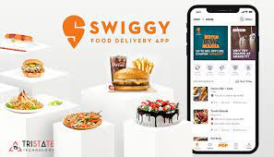
Swiggy – An Overview
Swiggy is an Indian online food ordering and delivery platform.
Founded in 2014, Swiggy is headquartered in Bangalore and operates in more than 500 Indian cities as of September 2021.
Besides food delivery, the platform also provides on-demand grocery deliveries under the name Instamart, and same-day package delivery service called Swiggy Genie.

Slide 3
Orders Taken VS

Slide 4
Revenue Based on Orders

Slide 5
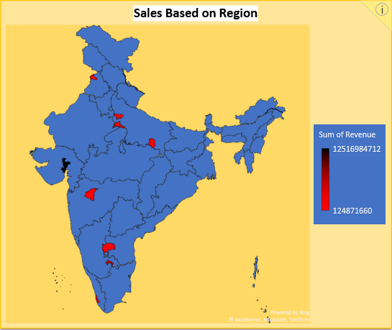
Revenue Based on Region

Slide 6
Analysis & Recommendations Based on Customer Orders
High orders are placed in Friday as it’s the starting of weekend.
We have to provide some weekend offers to increase the sale during weekend as the sales are less when compared to week days.

Slide 7
Customer Analysis - Cashback/Redeem Discounts

Slide 8
Region analysis
Around 13k locations are not updated. We have to ask either restaurants to update within a week or needs to be removed from application.

Slide 9
Restaurants Analysis
251 Licenses are not licensed.
The restaurants not licensed need to apply for license and we can announce 100% Trusted Restaurants in SWIGGY.
If not needs to be removed from application.

Slide 10


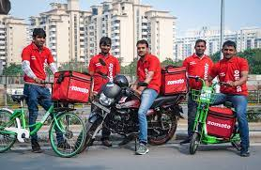
Lets encourage
Providing rewards which can be renewed as Cash.
Delivery Boys – Rewards for delivery within time
Customers – more than 3 orders in a week
Restaurants – Based on food Quality, License and Quick Service

